Slide 1
syrmDesign modifications
February 2017
simone.ferrari@polito.it

Slide 2
Content
Introduction
Winding factor evaluation: torque and PF
Winding factor evaluation: MTPA estimation
Flux barriers with constant permeance
Designed motors
Different barriers: torque and torque ripple
Conclusions

Slide 3
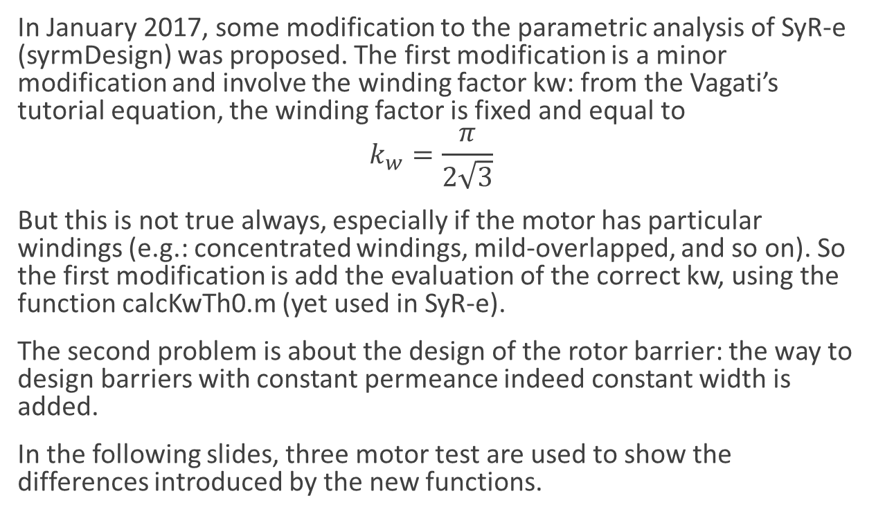
Introducion
In January 2017, some modification to the parametric analysis of SyR-e (syrmDesign) was proposed. The first modification is a minor modification and involve the winding factor kw: from the Vagati’s tutorial equation, the winding factor is fixed and equal to
$$k_{w}=\frac{π}{2\sqrt{3}}$$
But this is not true always, especially if the motor has particular windings (e.g.: concentrated windings, mild-overlapped, and so on). So the first modification is add the evaluation of the correct kw, using the function calcKwTh0.m (yet used in SyR-e).
The second problem is about the design of the rotor barrier: the way to design barriers with constant permeance indeed constant width is added.
In the following slides, three motor test are used to show the differences introduced by the new functions.

Slide 4
Winding factor evaluation : torque and PF
The figures show the error (in p.u.) between the analytically evaluated performances and the FEA evaluated performances.
The center of the plot is the results from syrmDesign
The MTPA (square points) have the same values, but in this plane seems different because of the different base value.
Evaluating the correct kw, the error between syrmDesign and FEA (@ same gamma, circle) is higher than constant kw, but the error between the estimated performances (square) and MTPA is lower

Slide 5
Winding factor evaluation: MTPA estimation
The figures show the torque and PF normalized @ MTPA values. The contour is the per-units error
You can see that the better estimation is the one with evaluated kw (blue circle)

Slide 6
Flux barrier with constant permeance
At the begin, syrmDesign draw all the barrier with constant width. Using barriers with constant permeance might allow lower torque ripple and will be useful if PMs are added in the barriers, because the working point will be quite the same.
Three solution with constant permeance are explored: one with dx=0, one with flux carrier width (iron) proportional to the d-flux (proportional to the integral of the cosine centered on the d-axis) and one with constant width of flux carriers.
NOTE: the permeance is evaluated with dx=0 and disregarding the tangential ribs.

Slide 7
Designed motors – hc=cost
36S4P
36S6P
48S8P

Slide 8
Designed motors – pb=cost, dx=0
36S4P
36S6P
48S8P

Slide 9
Designed motors – pb=cost, Fe prop flux
36S4P
36S6P
48S8P

Slide 10
Designed motors – pb=cost, Fe=cost
36S4P
36S6P
48S8P

Slide 11
Different barriers: torque and torque ripple
The figures show the torque and the peak to peak torque ripple at the rated current along the MTPA
The rotor with constant barrier width is always worst than the rotors with constant permeance (the torque ripple is higher)
It is impossible to say which are the best way to set the dx, because the local saturation is important. A good compromise is to have constant iron width (probably it is due to have constant step at the airgap between the barriers)

Slide 12
Conclusion
The modifications in syrmDesign are presented. The suggested way to act is:
Evaluated winding factor
Barriers with constant permeance and constant iron width for the rotor flux carriers
By the way, is possible to change this, thanks to the introduction of 3 flags, settable at the begin of syrmDesign.m:
flag_kw: to set the way to evaluate the winding factor (default=1)
flag_pb: to select use constant barrier width or permeance (default=1)
flag_dx: to select how evaluate the dx, with constant permeance (default=1)

